Slide 1
GLOBAL E-COMMERCE SALES & CUSTOMER DATA
Presented by :-
Nagula vaishnavi

Slide 2
INTRODUCTION
E-commerce is growing globally
Businesses need data analysis to understand:
Sales trends
Customer behavior
This project analyzes global sales data using Power BI

Slide 3
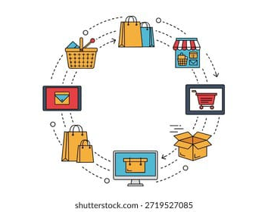
OVERVIEW
Analysis of global e-commerce data
Focus on sales, customers, and regions
Developed using Power BI
Created interactive dashboards

Slide 4
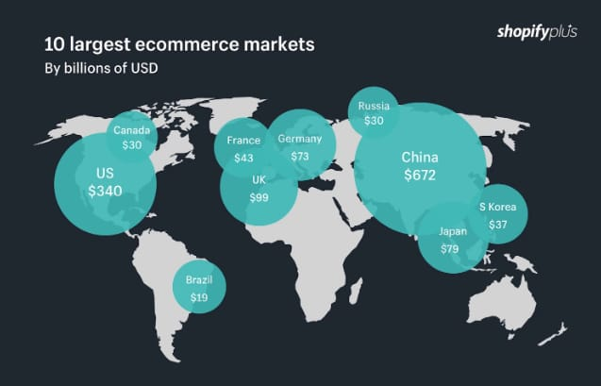
OBJECTIVES
Analyze sales performance
Identify top products & regions
Understand customer behavior
Improve business decision-making

Slide 5
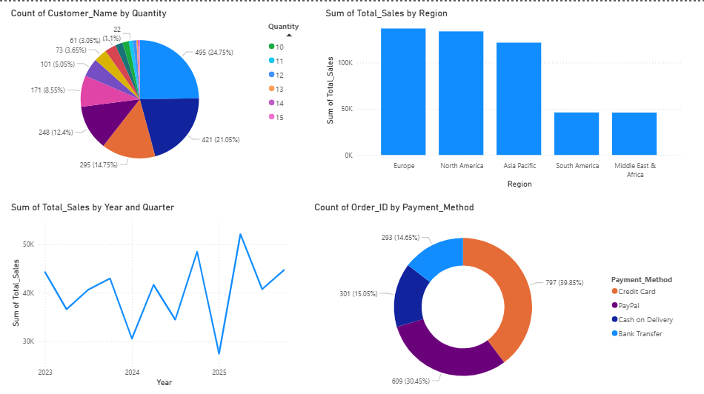
KEY PERFORMANCE INDICATORS (KPIS)

Slide 6
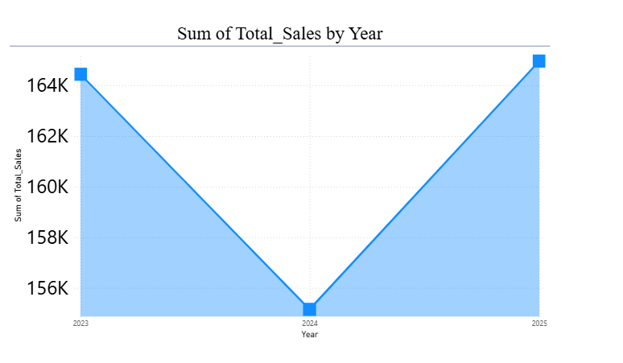
SALES TREND
The line chart represents the trend of total sales over the years.
Sales were high in 2023, showing strong business performance.
In 2024, sales decreased, indicating a temporary decline in demand or market conditions.
In 2025, sales increased again, showing recovery and growth.

Slide 7
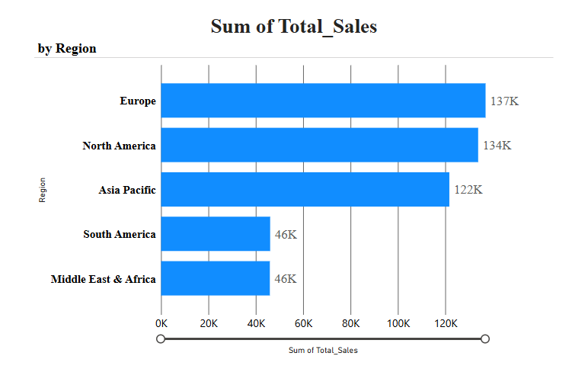
REGION ANALYSIS
Europe has highest sales (137K)
North America is second (134K)
Asia Pacific shows good growth (122K)
South America has lower sales (46K)
Middle East & Africa also low (46K)
Top regions: Europe & North America
Other regions need improvement

Slide 8
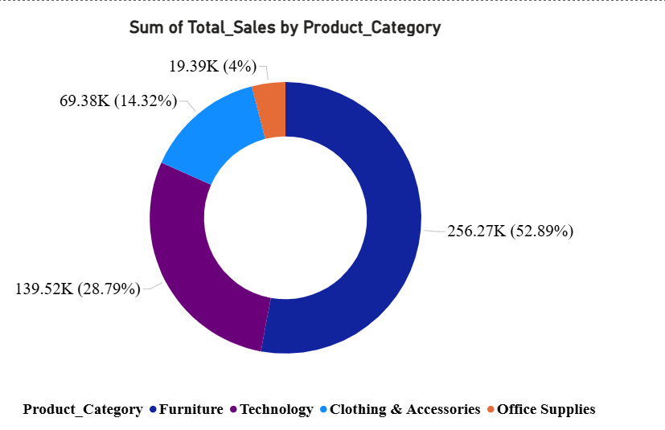
CATEGORY DISTRIBUTION
Furniture has highest sales (52.89%)
Technology is second (28.79%)
Clothing & Accessories contribute moderately (14.32%)
Office Supplies have lowest share (4%)
Technology dominates overall sales
Other categories show growth potential

Slide 9
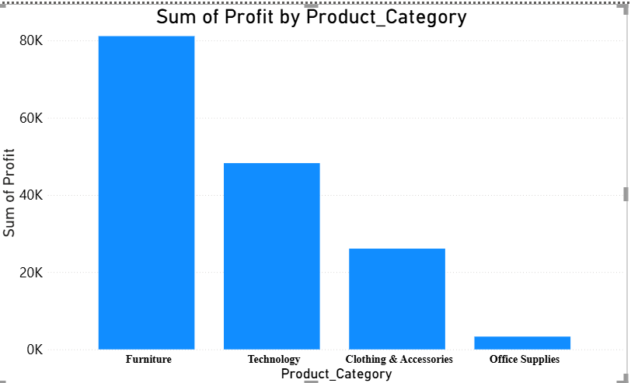
PROFIT ANALYSIS
Furniture gives highest profit (~80K)
Technology is second (~50K)
Clothing & Accessories show moderate profit (~30K)
Office Supplies have lowest profit (~10K)
Furniture is most profitable category
Office Supplies need improvement

Slide 10
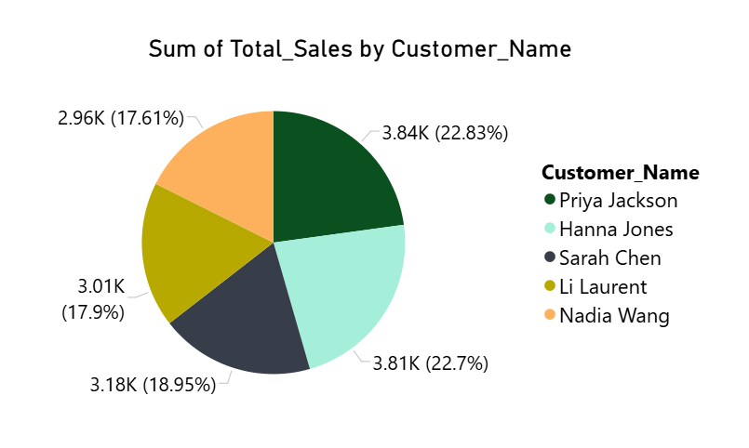
CUSTOMER ANALYSIS
Shows Top 5 customers by total sales
Priya Jackson is highest contributor (~22.83%)
Hanna Jones is second (~22.7%)
Remaining customers contribute similar shares
Sales distribution is balanced among top customers
No single customer dominates completely

Slide 11
INSIGHTS AND RECOMMENDATION
INSIGHT
Sales decreased in 2024
Sales recovered in 2025
Some regions contribute more sales
Certain products perform better
RECOMMENDATION
Focus on high-performing regions
Improve low-performing categories
Increase customer retention strategies
Use marketing to boost sales

Slide 12
CONCLUSION
Built interactive dashboards using Microsoft Power BI Desktop
Identified sales trends over time
Analyzed customer behavior and contribution
Helped in identifying top-performing areas and weak segments
Enabled data-driven decision making
Useful for improving business strategies and growth

Slide 13
THANKYOU
THANKYOU

